Slide 1
presentation on TIC and technologies related to TIC
By Benslimane Salima Lamia
Section A
03/01/2023

Slide 2
Introduction to TIC
Ⅰ
Ⅳ
Microsoft Tools
Ⅱ
Content
Table
Ⅴ
Git and GitHub
TIC Components
Google Services
Ⅲ
Ⅵ
Future Trends
and Conclusion

Slide 3

Information and Communication Technologies (ICT) encompass a wide range of technologies used for collecting, processing, storing, transmitting, and presenting information. It includes hardware, software, networks, and data, playing a crucial role in communication and information manipulation. ICT is pervasive in modern society, impacting various sectors and contributing to globalization and innovation. The constant evolution of ICT leads to the development of new technologies and applications, shaping the way individuals, businesses, and governments interact with and utilize information.
Ⅰ- Introduction to TIC
1- Definition of TIC:

Slide 4
2- Significance in modern society
Information and Communication Technologies (ICT) hold immense significance in modern society by transforming communication, fostering global connectivity, and influencing various aspects of daily life. ICT facilitates instant communication, provides access to information, drives economic growth, revolutionizes education and healthcare, enhances government services, and contributes to social interactions. It is a catalyst for innovation, research, and globalization, playing a pivotal role in shaping the way individuals,businesses, and governments operate and interact in the contemporary world.

Slide 5
Ⅱ- TIC components
1-hardware software network and data
Explanation: Physical components like the CPU, memory, and peripherals that make up a computer system.
Importance: The foundation of computing, hardware enables the execution of software, storage of data, and interaction with users
Explanation: Programs and instructions that govern the operation of computer hardware.
Importance: Drives functionality, allowing users to perform tasks, run applications, and manage system resources
Explanation: Interconnected systems enabling communication and data exchange between computers and devices.
Importance: Forms the backbone of modern communication, facilitating collaboration, resource sharing, and access to information.
Explanation: Information in various formats processed and stored by computer systems.
Importance: Essential for decision-making, analysis, and knowledge creation, effective data management is crucial for organizational success and innovation.
Hardware
Software
Networks
Data

Slide 6
Hardware
Software
Network
Data
Role: The physical components of a computer system.
Key Elements: CPU, memory, storage devices, peripheral devices.
Role: Provides the foundation for computing, enabling the execution of software, storage of data, and interaction with users.
Role: Programs and instructions governing hardware operation.
Key Elements: Operating systems, applications, utilities.
Role: Drives the functionality of hardware, allowing users to perform tasks, run applications, and manage system resources.
Role: Interconnected systems facilitating communication and data exchange.
Key Elements: Routers, switches, protocols, cables.
Role: Forms the backbone of communication, enabling collaboration, resource sharing, and access to remote information.
Role: Information in various formats processed and stored by computer systems.
Key Elements: Databases, files, data structures.
Role: Essential for decision-making, analysis, and knowledge creation; effective data management is crucial for organizational success and innovation.

Slide 7
standard computer system with four key components of Information and Communication Technologies (ICT):
Hardware (Computer):
Software (Code Snippet):
Networks (Connected Nodes):
Data (Database):

Slide 8
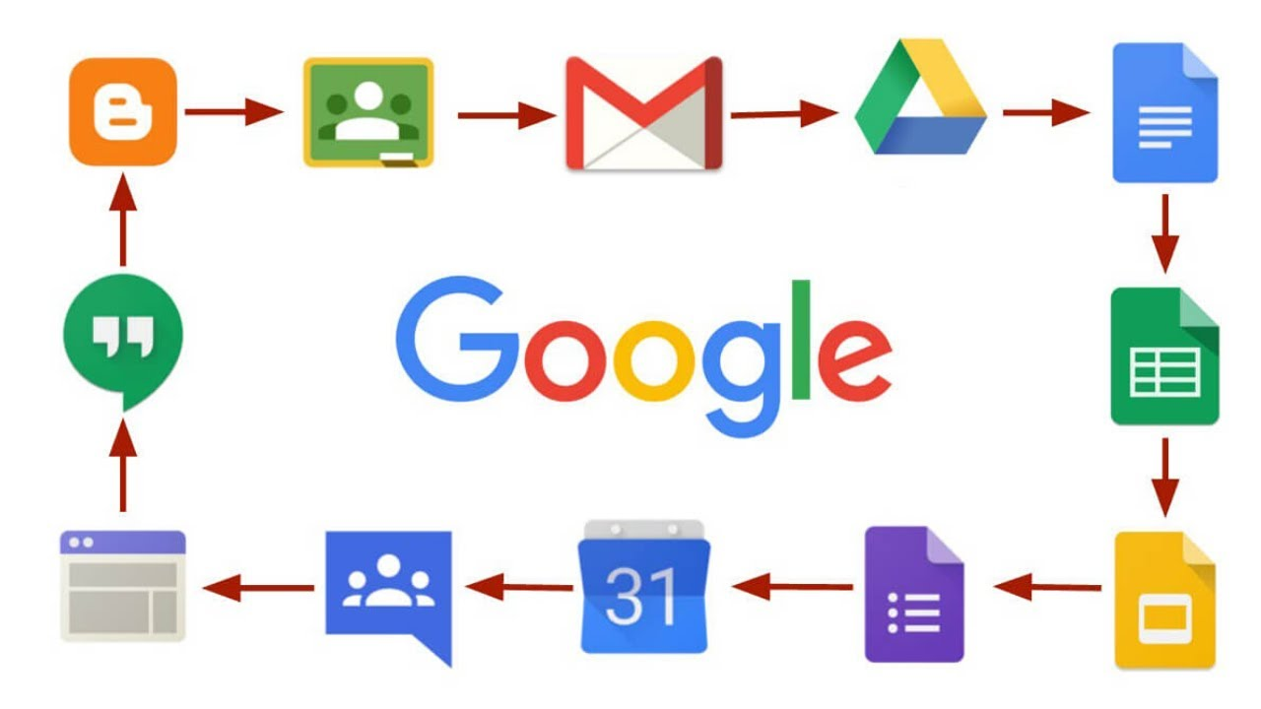
Ⅲ-Google services
Description: A popular email service with a user-friendly interface, powerful search capabilities, and robust spam filtering.
Usage: Email communication, file attachments, integration with other Google services.
Description: A cloud-based spreadsheet application for creating, editing, and analyzing data with features such as formulas, charts, and collaboration capabilities.
Usage: Data analysis, budgeting, project management.
Description: A cloud-based word processing application that allows users to create and edit documents collaboratively in real-time.
Usage: Document creation, editing, and collaboration
Description: A cloud storage service that enables users to store, access, and share files and documents seamlessly. It includes collaboration tools like Google Docs, Sheets, and Slides
Usage: File storage, document collaoration, sharing and synchronization.
.
Description: A cloud-based presentation tool that enables users to create and edit slideshows collaboratively.
Usage: Presentation creation, collaboration, and sharing.
Description: The world's most widely used search engine. It allows users to find information on the internet by entering search queries.Usage: Information retrieval, research, general knowledge.
Description: A mapping service providing detailed maps, satellite imagery, and route planning, along with features like local business information and street views.
Usage: Navigation, location services, exploring local areas.

Slide 9
Ⅳ- Microsoft Tools
Description: Microsoft Word is a word processing application allowing users to create, edit, and format text documents.
Usage: Document creation, formatting, collaborative writing.
Description: Microsoft Excel is a spreadsheet application for organizing, analyzing, and visualizing data using features like formulas and charts.
Usage: Data analysis, budgeting, financial modeling.
Description: Microsoft PowerPoint is a presentation software enabling users to create and deliver dynamic slideshows with multimedia elements.
Usage: Presentation creation, storytelling, visual communication.

Slide 10
Teams collaboration platform Azure Cloud Services
Introduction
Microsoft Teams and Azure Cloud Services are key components in Microsoft's ecosystem, combining collaboration and cloud computing.
Microsoft Teams
Collaboration platform offering real-time chat, video conferencing, file sharing, and application integration.
Teams in Action
Demonstrates practical scenarios showcasing Teams' role in enhancing remote collaboration and project management.
Azure Cloud Services
Azure, Microsoft's cloud computing platform, provides IaaS, PaaS, and SaaS solutions for various applications.
Azure Cloud Applications
Highlights use cases for Azure Cloud Services, including scalable applications, data storage, and advanced analytics.
Integration of Teams and Azure
Illustrates how Teams seamlessly integrates with Azure, creating a collaboration powerhouse with centralized communication and secure data storage.

Slide 11
Microsoft Office Suite vs. Microsoft Teams
Features | Microsoft Office Suite | Microsoft Teams
Communication | Email, Comments in Documents | Real-time Chat, Video Conferencing
Document Creation | Word, Excel, PowerPoint | Collaborative Editing in Word, Excel
Collaboration | Review and Edit Documents | Team Channels, File Sharing
Project Management | Limited (SharePoint integration) | Planner, Task Management
Meetings and Calls | Skype Integration, PowerPoint in Calls | Seamless Video Conferencing
Integration with Teams | SharePoint, OneDrive | Direct Integration with Microsoft 365
Cloud Storage | OneDrive | SharePoint, OneDrive Integration
Collaborative Editing | Co-authoring in Word, Excel, PowerPoint | Real-time Editing in Microsoft Teams
Mobile Accessibility | Mobile Versions of Apps | Dedicated Mobile App for Teams

Slide 12
Ⅴ- Git and GitHub
1-Introduction to Version Control with Git
Definition: Version control is a system that tracks changes in a project's codebase, allowing multiple contributors to collaborate efficiently and maintain a history of revisions.
Importance:
Enables collaboration: Multiple developers can work on the same project simultaneously without conflicts.
History tracking: Every change is recorded, providing a timeline of modifications.
Rollback capabilities: Easily revert to previous versions in case of errors.
Git Overview:
Distributed System: Git is a distributed version control system, allowing each user to have a complete copy of the repository.
Branching: Git facilitates parallel development with branches, enabling the creation of separate lines of development.
Basic Concepts:
Commit: Each snapshot of the project is a commit, providing a checkpoint in the project's history.
Branch: A separate line of development, useful for feature implementation or bug fixing.
Merge: Combining changes from different branches.
Collaborative Workflow:
Developers clone a repository.
Create branches for tasks.
Make commits.
Merge changes to the main branch.
Popular Platforms:
GitHub, GitLab, Bitbucket: Web-based platforms that host Git repositories, facilitating collaboration and integration with CI/CD pipelines

Slide 13
GitHub for Collaborative Software Development
Definition:
GitHub is a web-based platform that utilizes Git for version control and provides collaboration tools, making it a central hub for software development projects.
Key Features:
Repository Hosting: Stores and manages Git repositories.
Collaboration: Facilitates teamwork through issues, pull requests, and discussions.
Branching: Supports parallel development with branches for features or bug fixes.
Code Review: Enables detailed code review through pull requests.
Workflow:
Developers clone a repository.
Create branches for tasks.
Make commits to their branches.
Open pull requests for code review.
Merge changes into the main branch.
Visibility and Transparency:
Open-source projects on GitHub are accessible to the public, promoting transparency and community involvement.
Issue Tracking:
GitHub Issues help manage and prioritize tasks, bugs, and enhancements.
Integration:
Integrates with various tools and services, including continuous integration (CI) platforms, to automate workflows.
Community Engagement:
Developers can follow projects, contribute through pull requests, and participate in discussions, fostering a collaborative community.
Documentation:
GitHub Pages allows the creation of project documentation, enhancing accessibility for users and contributors.
Examples:
Many well-known open-source projects, like Node.js and TensorFlow, use GitHub for collaborative development.

Slide 15
Artificial Intelligence (AI), Internet of Things (IoT), and emerging technologies are transformative forces shaping the landscape of Technology and Information Communication (TIC).
Key Aspects:
AI:
Intelligence simulation in machines, enabling tasks that typically require human intelligence.
Applications: Machine learning, natural language processing, computer vision.
IoT:
Network of interconnected devices that communicate and share data seamlessly.
Applications: Smart homes, industrial automation, healthcare.
Emerging Technologies:
Includes blockchain, augmented reality, quantum computing, and more.
Diverse applications across industries, driving innovation.
TIC Integration:
Connectivity: TIC relies on interconnected systems facilitated by technologies like IoT.
Automation: AI and emerging tech contribute to automated processes and decision-making.

Slide 16
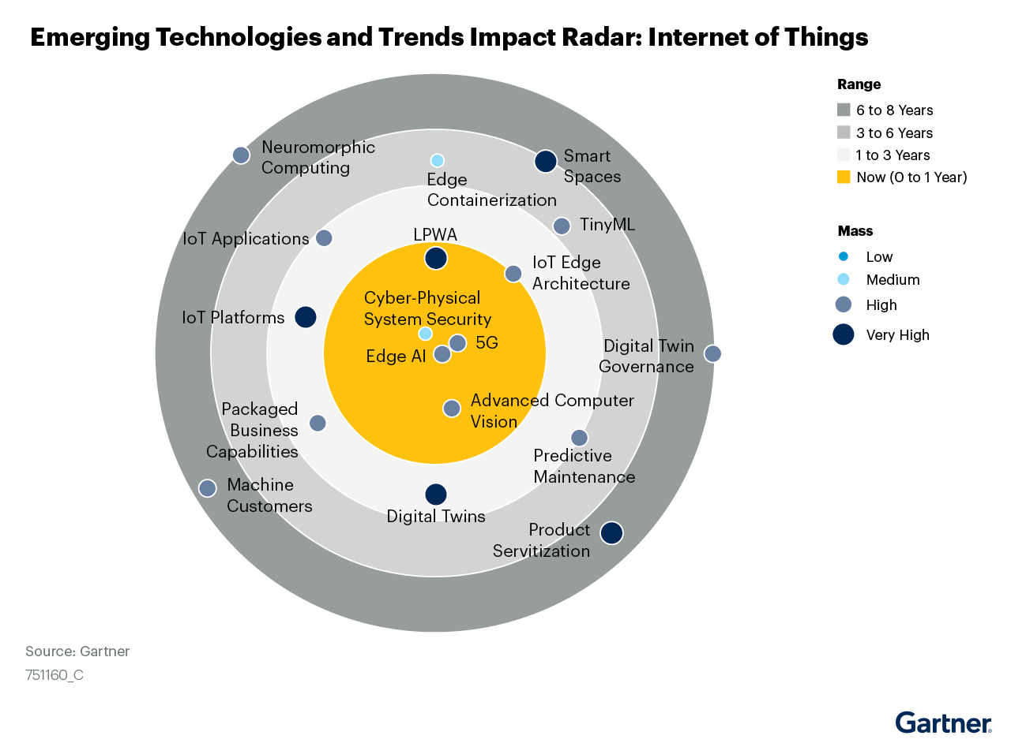

Slide 17
Conclusion:
The convergence of AI, IoT, and emerging technologies is driving the evolution of TIC, influencing how we connect, process information, and innovate

